Slide 1
CAD System
Deep Learning Approach
Tewodros Arega, Abdullah Thabit

Slide 2
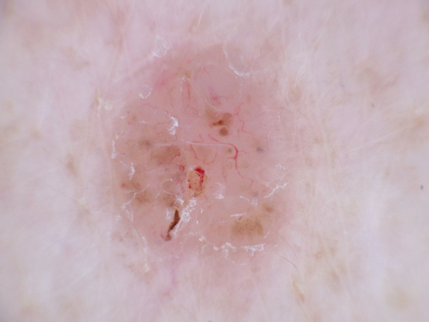
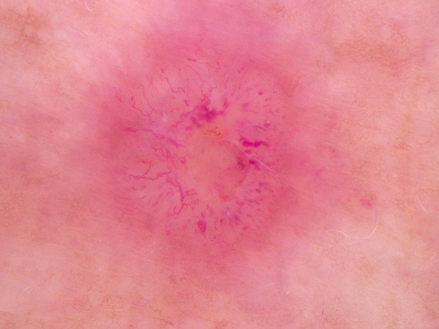
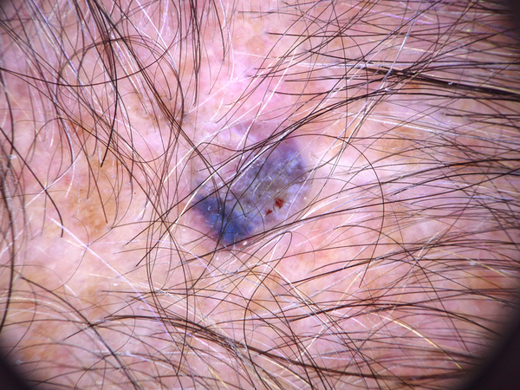
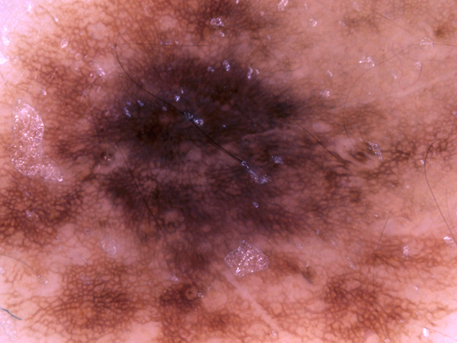




Project Objectives
Build a CAD system to address two main problems:
Skin Lesion Classification
6000 images (half benign and half other classes)
Histopathology Classification
29494 images (half benign and half malignant)

Slide 3
CAD System Framework
Feature Extraction
Classification
Pre-processing
Data Preparation
Benign
Malignant
Deep Learning Model

Slide 4
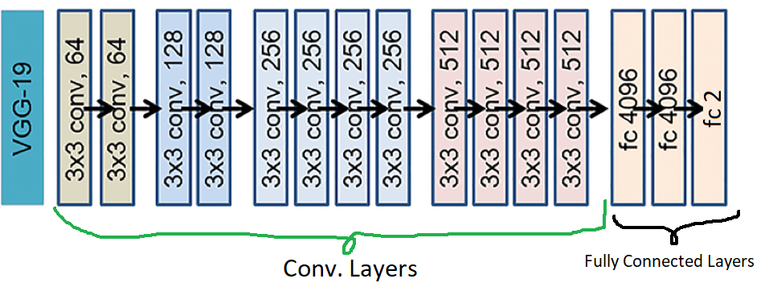
BaseLine
VGG - 19
Resize Image to 224*224
Normalization
Transfer Learning
Classification
Sensitivity | Specificity | Accuracy
0.8150 | 0.7717 | 0.7933

Slide 5
Fine-Tuning
VGG - 19
Resize Image to 224*224
Normalization
Fine-Tuning
Classification
Sensitivity | Specificity | Accuracy
0.8767 | 0.9000 | 0.8883

Slide 6
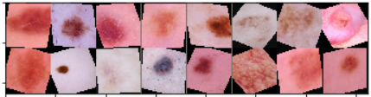
Data Augmentation
Resize Image to 300*300
Random Crop (224*224)
Color Augmentation
Random Affine(rotation, shearing)
Normalization
Horizontal and Vertical Flip

Slide 7
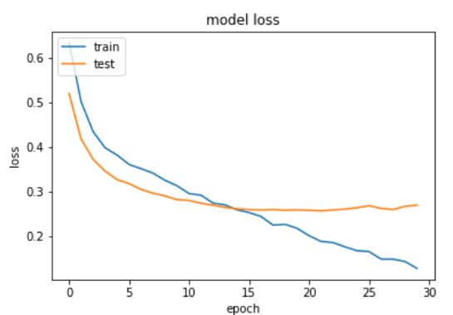
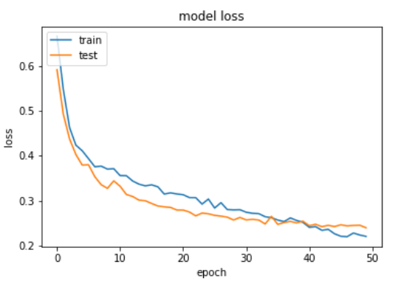
Data Augmentation
Before Data Augmentation
After Data Augmentation

Slide 8
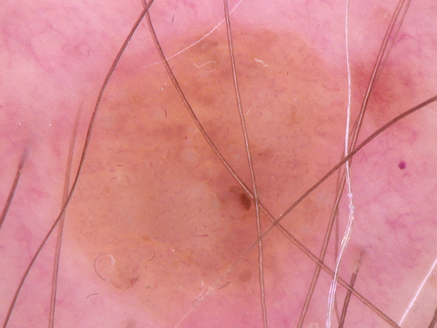
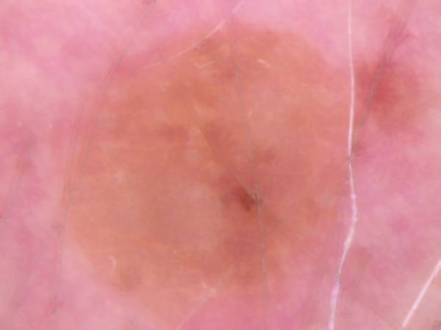
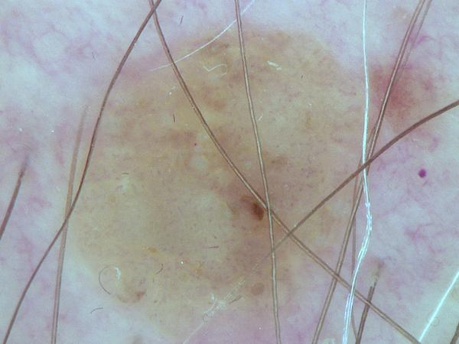
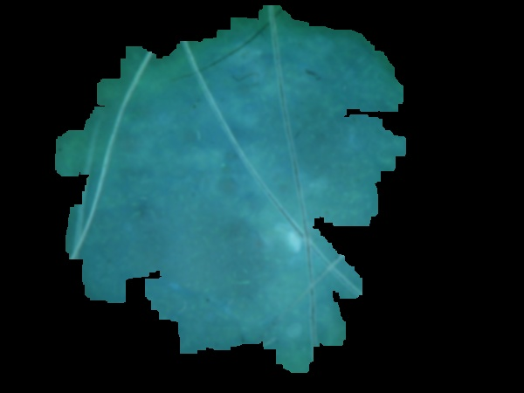
Preprocessing
Original Image
Hair Removal
Color Constancy
Lesion Segmentation

Slide 9
Preprocessing

Slide 10
Network Architectures
VGG - 19
Inception-V3
MobileNet-V2
Resnet(50,152)
Senet
Densenet-161

Slide 11
Model Comparison
Model | Sensitivity | Specificity | Accuracy
VGG-19 | 0.900662 | 0.90604 | 0.9033
Inceptionv3 | 0.8567 | 0.875 | 0.8658‬
Resnet-152 | 0.9017 | 0.895 | 0.8983
SENET | 0.8533 | 0.8383 | 0.8458
MobileNetV2 | 0.8962 | 0.905565 | 0.9008
Densenet-161 | 0.9083 | 0.9235 | 0.9158

Slide 12
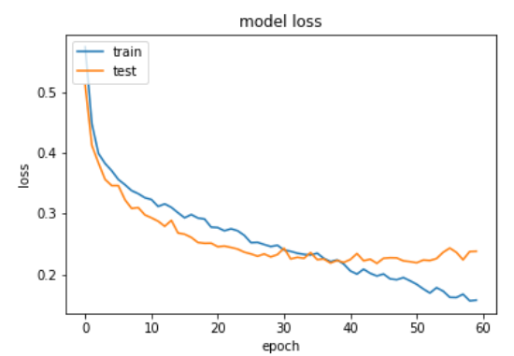
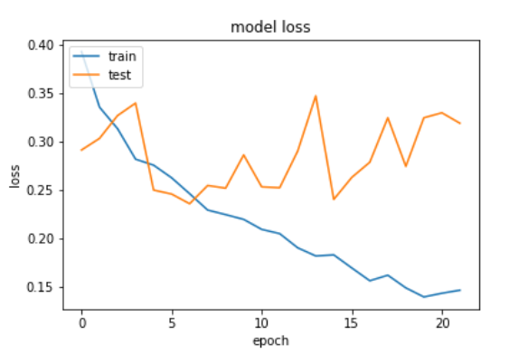
Model Comparison
Densenet-161
MobileNet-V2

Slide 13
Hyperparameter Tuning
Loss | Optimizer | Weight Decay | BatchSize | Weight Init | Epochs | Accuracy
Crossentropy | Adadelta | 1.00E-04 | 32 | ImageNET | 40 | 0.9025
Focal Loss | Adadelta | 1.00E-04 | 16 | ImageNET | 40 | 0.8983
Crossentropy | Adadelta | 1.00E-04 | 16 | ImageNET | 40 | 0.9158
Crossentropy | Adadelta | 1.00E-04 | 8 | ImageNET | 40 | 0.9108
Crossentropy | Adam | 1.00E-06 | 16 | ImageNET | 40 | 0.8817
Crossentropy | SGD | 1.00E-06 | 16 | ImageNET | 10 | 0.8933
Crossentropy | Adadelta | 1.00E-04 | 16 | Uniform | 40 | 0.7875

Slide 14
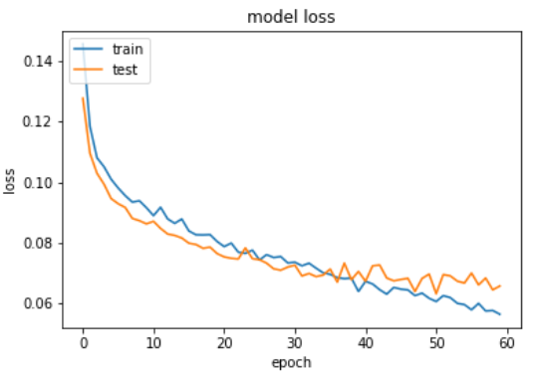
Hyperparameter Comparison
CrossEntropy
Focal Loss
Sensitivity | Specificity | Accuracy
0.9083 | 0.9235 | 0.9158
Sensitivity | Specificity | Accuracy
0.8916 | 0.905 | 0.8983

Slide 15
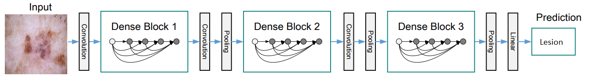
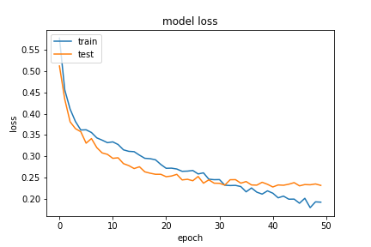
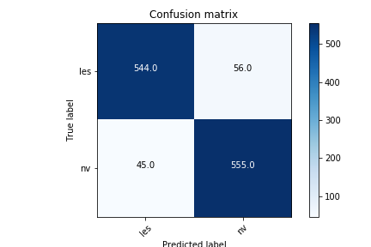
Best Model
Densenet-161
Sensitivity | Specificity | Accuracy
0.9083 | 0.9235 | 0.9158

Slide 16
Discussion
SDG Optimizer converges faster than Adam
Preprocessed Images didn’t improve the result
Data Augmentation reduced overfitting and increased the accuracy

